Slide 1
Lecture 11 Perceptron
Abrar Hasan
Lecturer
Dept. of Software Engineering

Slide 2
1
Perceptron
<
T
1
>

Slide 3
Perceptron
<
T
1
>
The Perceptron is the simplest form of a neural network model, serving as a binary linear classifier. It's designed to separate data into two classes by finding a hyperplane (a line in 2D, plane in 3D, etc.) that divides the data.

Slide 4

Perceptron
<
T
1
>
b
w1
x1
x2
w2
x3
w3

Slide 5
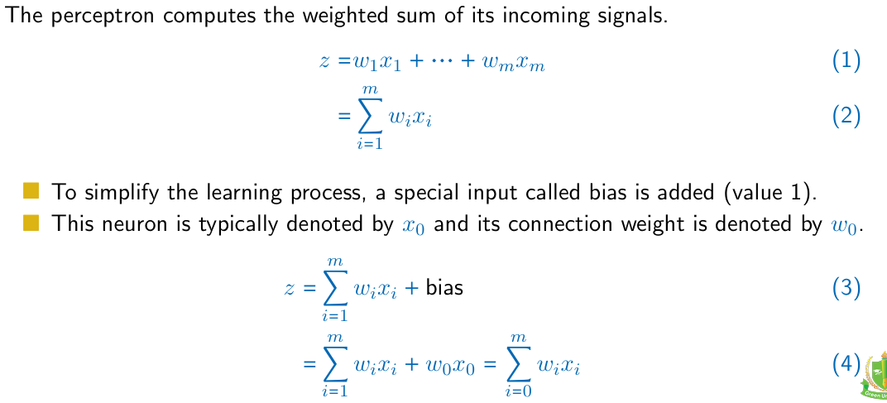
Perceptron
<
T
1
>

Slide 6
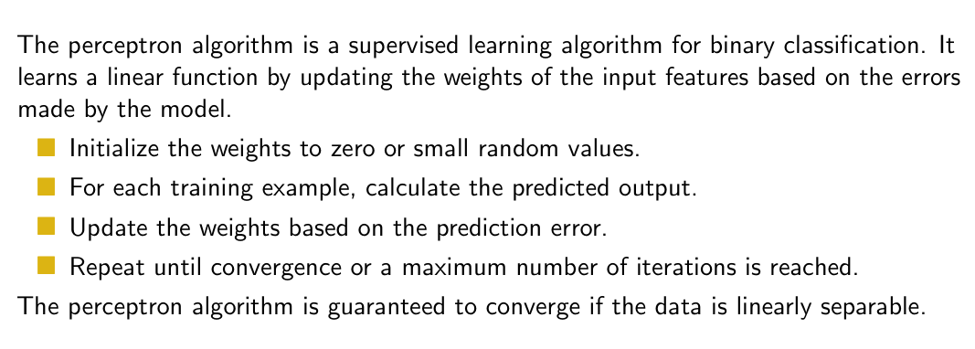
Perceptron
<
T
1
>

Slide 7
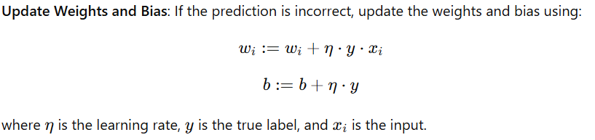
Perceptron
<
T
1
>

Slide 8
Perceptron
<
T
1
>
X1 | X2 | Output
1 | 1 | 1
-1 | 1 | -1
1 | -1 | -1
-1 | -1 | -1

Slide 9

Perceptron
<
T
1
>
W1 = w2= b=0
b
X1 | X2 | Output
1 | 1 | 1
-1 | 1 | -1
1 | -1 | -1
-1 | -1 | -1
w1
x1
w2
x2

Slide 10
Perceptron
<
T
1
>
W1 = w2= b=0
b=0
X1 | X2 | Output
1 | 1 | 1
-1 | 1 | -1
1 | -1 | -1
-1 | -1 | -1
Predicted Value
-1
1
W1 =0
W2=0
1
x₁w₁+x₂w₂+b
= 1 * 0+ 1*0+0
=0

Slide 11
Perceptron
<
T
1
>
So Update the weights
w_{1new}= w_{1old} + (learning Rate) (y)(x₁)
= 0 + (1) (1) (1)
= 1
X1 | X2 | Output
1 | 1 | 1
-1 | 1 | -1
1 | -1 | -1
-1 | -1 | -1
w_{2new}= w_{2old} + (learning Rate) (y)(x₂)
= 0 + (1) (1) (1)
= 1
B_{new}= w_{old} + (learning Rate) (y)
= 0 + (1) (1)
= 1

Slide 12
Perceptron
<
T
1
>
So Update the weights
w_{1new} = 1
w_{2new} = 1
B_{new} =1
X1 | X2 | Output
1 | 1 | 1
-1 | 1 | -1
1 | -1 | -1
-1 | -1 | -1
x₁w₁+x₂w₂+b
= 1 * 1+ 1*1+1
=3
After Sigmoid Predicted Value = 1
Actual Output = -1
So update the weights

Slide 13
Thank You

